Slide 1
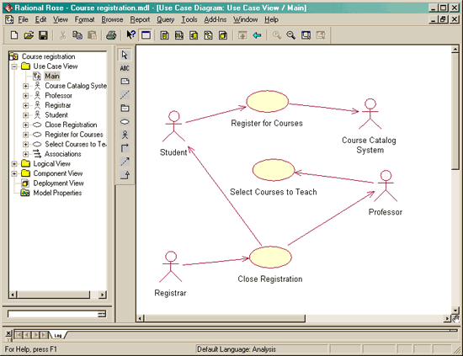
Generating the Test Case from Use Case
Use cases is visually requirements description is based on UML (Unified Modeling Language).

Slide 2
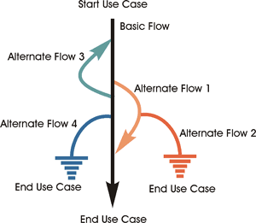
Pembentukan Test Case
Pembentukan test case berdasarkan basic flow (sistem berjalan dg normal) dan alternate flow (alternatif jalannya sistem).

Slide 3
Contoh
Flow Normal : Logon -> Select “Create Schedule” -> Obtain Course Information -> Select Course -> Submit Schedule -> Display Completed Course
Alternate Flow: Unidentified Student; Quit at anytime; Unfulfilled Prerequisite, Course Full, Schedule Conflict; Course Catalog Unavailable; Course Registration is Closed.

Slide 4
Use Case Scenario
Scenario 1 | Basic Flow
Scenario 2 | Basic Flow | Alternate Flow 1
Scenario 3 | Basic Flow | Alternate Flow 1 | Alternate Flow 2
Scenario 4 | Basic Flow | Alternate Flow 3
Scenario 5 | Basic Flow | Alternate Flow 3 | Alternate Flow 1
Scenario 6 | Basic Flow | Alternate Flow 3 | Alternate Flow 1 | Alternate Flow 2
Scenario 7 | Basic Flow | Alternate Flow 4
Scenario 8 | Basic Flow | Alternate Flow 3 | Alternate Flow 4

Slide 5
Three-step process for generating test cases from a fully-detailed use case:
For each use case, generate a full set of use-case scenarios.
For each scenario, identify at least one test case and the conditions that will make it "execute."
For each test case, identify the data values with which to test.

Slide 6
Step One: Generate Scenarios
Read the use-case textual description and identify each combination of main and alternate flows -- the scenarios -- and create a scenario matrix.
Scenario Name | Starting Flow | Alternate
1: Successful Registration | Basic Flow
2: Unidentified User | Basic Flow | A1
3: User quits | Basic Flow | A2
4: Course Catalog Unavailable | Basic Flow | A4
5: Registration Clossed | Basic Flow | A5
6: Cannot Enroll | Basic Flow | A3

Slide 7
Step Two: Identify Test Cases
Id | Scenario | Stud. Id | Password | Course Selected | Prereq. Fulfilled | Course Open | Schedule Open | Test Result
RC1 | 1: Successful Registration | V | V | V | V | V | V | Schedule and Confirmation Number Displayed
RC 2 | 2: Unidentified student | I | N/A | N/A | N/A | N/A | N/A | Err. Msg.: Back To Login
RC 3 | 3: valid user quits | V | V | N/A | N/A | N/A | N/A | Login screen appeared
RC 4 | 4: course registration system unavailable | V | V | N/A | N/A | N/A | N/A | Err. Msg.: back to step 2
RC 5 | 5: registration closed | V | V | N/A | N/A | N/A | N/A | Err. Msg.: back to step 2
RC 6 | 6: Coure Full | V | V | V | V | I | V | back to step 3
RC 7 | 7: Pre-req. Not fulfilled | V | V | V | I | V | V | back to step 4
RC 8 | 8: Schedule Conflict | V | V | V | V | V | I | back to step 4

